Slide 1
Personal Auto Insurance Rating
Kevin McBeth, FCAS, MAAA

Slide 2
Kevin McBeth FCAS, MAAA
Senior Actuary & Head of Data Science
Explore Information Services
Minneapolis, MN
Fellow of the Casualty Actuarial Society
Member of the American Academy of Actuaries
B.S. from Kansas State (2007)
Economics, Mathematics, & Statistics

Slide 3
OUTLINE
Insurance Industry Overview
Personal Auto
How to Save Money on Auto Insurance
How Not to Save Money on Auto Insurance
Questions

Slide 4
Insurance Overview

Slide 5
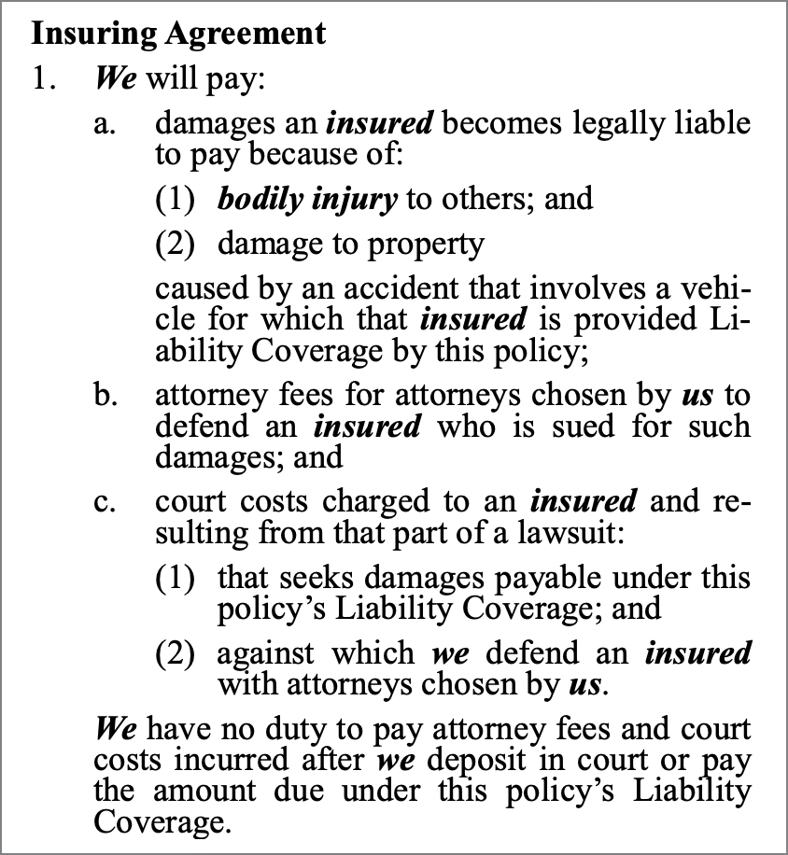
What is Insurance?
Insurance is a means of protection from financial loss. It is a form of risk management, primarily used to hedge against the risk of a contingent or uncertain loss.
The insured pays a premium to an insurance company and receives receives a contract (the insurance policy) that details the conditions and circumstances under which the insurer will compensate the insured. If the insured experiences a loss covered by the policy, the carrier reimburses them for that loss subject to the terms of the contract.

Slide 6
United States Insurance Industry
Notes:
2018 Direct Written Premium
https://www.iii.org/fact-statistic/facts-statistics-industry-overview
Life & Annuity also includes $197.5B in health premium
P&C includes $6.5B in health premium
U.S. GDP is about $21.43 Trillion

Slide 7
Property & Casualty Insurance

Slide 8
Top 20 Property & Casualty Insurance GRoups
Company | Premium ($B)
State Farm | 65.6
Berkshire Hathaway | 46.1
Progressive | 39.2
Liberty Mutual | 35.6
Allstate | 35.0
Travelers | 28.0
USAA | 23.5
Chubb | 23.4
Farmers | 20.6
Nationwide | 18.4
Company | Premium ($B)
AIG | 14.0
Zurich | 12.9
The Hartford | 12.7
American Family | 11.5
CNA | 11.1
Auto Owners | 8.5
Assurant | 8.2
Erie Insurance | 7.5
Tokio Marine Holdings | 7.4
Fairfax Financial | 7.0

Slide 9
United States Insurance Regulation
Financial information available for all U.S. insurance carriers (NAIC “Yellow Book”)
Regulated on a state-by-state basis via “filings”
Filings outline the variables and coefficients each carrier uses for rating in each state
Rating must be “actuarially sound” (essentially cost + pricing model)
Each state determines which variables it deems acceptable to use for each type of insurance in their state
All your competitors can see what you’re doing

Slide 10
Personal Auto

Slide 11
Personal Auto Insurance
*Bodily Injury Liability pays for the other person’s medical expenses, rehabilitation, funeral costs, and other covered costs if you or your family are at fault in an auto accident
*Property Damage Liability pays when you or your family members damage other property in an accident.
*Personal Injury Protection (PIP or No-Fault) pays for medical expenses, rehabilitation, funeral expenses, lost wages, and in-home assistance for you and your passengers injured in an accident, regardless of who is at fault
*Uninsured/Underinsured Motorist Protection pays you or your passengers for medical, rehabilitation, and funeral costs.
Comprehensive pays for damage to your auto resulting from windstorm, fire, hail, etc.
Collision pays for the repair of your car in a collision or rollover.
* Denotes required by the state of Kansas
Notes:
* Denotes required by the state of Kansas

Slide 12
Personal Auto Premium Composition
Expense | Percent of Premium
Loss and Loss Adjustment Expense Ratio | 79.5%
Incurred Losses | 67.9%
Defense and Cost Containment Expenses | 2.6%
Adjusting and Other Expenses Incurred | 9.0%
Operating Expenses | 22.8%
Net Commission & Brokerage Expenses Incurred | 8.5%
Taxes, Licenses and Fees | 2.1%
Other Acquisition and Field Supervision Expenses Incurred | 7.2%
General Expenses Incurred | 5.0%
Dividends to Policyholders | 0.4%
Combined Ratio After Dividends | 102.7%

Slide 13
Two components of rating
Base Rate
Classification rating factors
Insurance carriers review and adjust their overall base rate to account for their loss and expenses ratios as well as target profitability.
Insurance carriers charge different insureds different rates based on attributes of the risk by grouping them into classes and assigning different relativities (factors) to those classes.

Slide 14
Setting the Base RAte
Estimated Average Losses = $800
Fixed Expense Per Policy = $200
Variable Expense = 15%
Target Profit = 5%
Notes:
\text{Base Rate} &= \frac{\text{Estimated Average Losses} + \text{Fixed Expense Per Policy}}{1 - \text{Variable Expense \%} - \text{Target Profit \%}}
\$1250 &= \frac{\$800 + \$200}{1 - 15\% - 5\%}

Slide 15
Criteria for Rating Variables
Statistical
Statistical Significance
Homogeneity
Credibility
Operational
Objective
Inexpensive
Verifiable
Social
Affordability
Causality
Controllability
Privacy Concerns
Legal

Slide 16
What variables are used in auto rating?
”It depends…”

Slide 17
Before we begin…
Every carrier rates auto insurance differently
Different carriers have different variables in their rating
Sometimes this even differs by state due to regulation
Even if two carriers have variables in common, the factors likely differ
Carriers go to different extents to verify variables
Some only verify when first writing someone (for example, ordering a Motor Vehicle Record at new business)
Some never verify some variables
Some have models to determine when to run reports

Slide 18
Categories of Personal Auto rating variables
Who you are
How you drive
Where you live
What you drive
Coverage Options

Slide 19
Variables – Who you Are
Age
Gender
Credit Score
Marital Status
“Householding”
Your Education
Your Occupation
Criminal Background
Source: thispersondoesnotexist.com

Slide 20
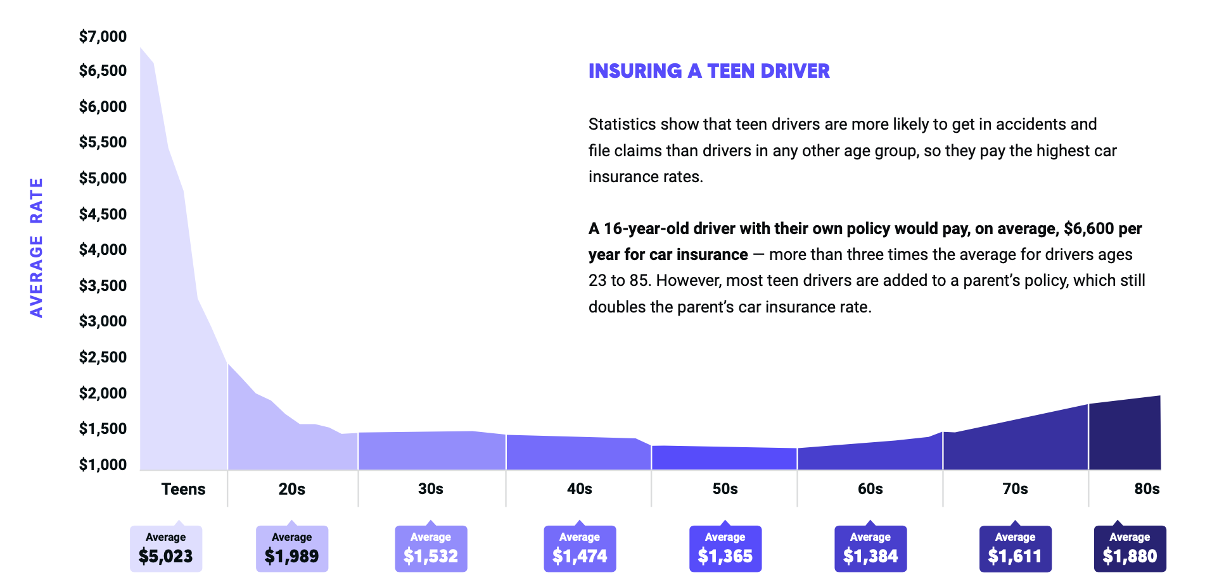
Variables – Who you Are - AGE
Source: The Zebra
Notes:
Graph shamelessly stolen from The Zebra

Slide 21
Variables – Who you Are - Gender
Historically Two Genders
Some states now have non-binary gender options
Hawaii, Massachusetts, Montana, and California prohibit gender in rating
The influence usually isn’t more than a few percent, and varies by age and location

Slide 22
Variables – Marital Status
On average, married people save about 6% in states that allow it

Slide 23
Variables – Who you Are – “Householding”
Instead of “one way” effects of Age, Gender, and Marital Status, carriers are building tables of factors based on combinations of people in the household

Slide 24
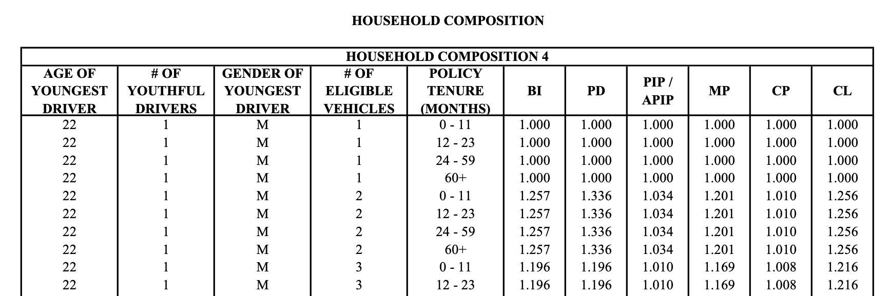
Variables – Who you Are – “Householding”

Slide 25
Variables – Who You Are – A few others
Education
Occupation
Criminal Background

Slide 26
Variables – How you Drive
Annual Mileage
Primary Vehicle Use
Accidents
Violations
Speeding
Distracted Driving
DUIs

Slide 27
Variables – How you Drive – Annual Mileage
Source: The Zebra

Slide 28
Variables – How you Drive –Vehicle Use
Pleasure
To/From Work
Farm
Business
Ridesharing

Slide 29
Variables – How you Drive – Accidents
Accidents are bad
At faults are often worse than not at faults
Many carriers age accidents off over time
Accidents aren’t to recoup losses
Individuals with accidents in prior years are more likely to have accidents in the upcoming policy period

Slide 30
Variables – How you Drive – Violations
Less serious violations can be a few percent increase
Bad violations are pricey: DUIs, refusing breathalyzer, racing, and hit and runs can increase premiums by over $1,000
Speeding
Distracted Driving
DUIs

Slide 31
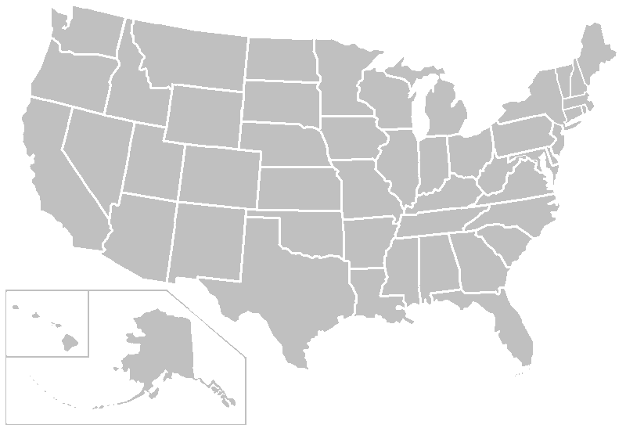
Variables – Where you live
State
Required coverages
Required limits
Territory within state
Rural vs. Urban
Storm propensity
Notes:
Most expensive: MI ($3,100/yr), LA ($2,400/yr), FL
Least Expensive: ME ($935/yr), NC $955/yr), VA ($1,005/yr)
Most expensive: Detroit ($6,200), New Orleans ($3,735), Hialeah, FL $3,179, Miami ($3075)
Least Expensive: Winston-Salem ($847), Greensboro ($945), Durham ($951)

Slide 32
Variables – Where you live

Slide 33
Variables – What you drive
Expensive Vehicles Cost More to Replace
Heavy vehicles cause greater injuries
Safety Features Increase Repair Costs
Notes:
BMW i8 is over $4,000
Tesla Model S is about $3,500 – Elon Musk Insurance Company
Fiat 500, Subaru Outback, Ford Escape, Honda CRV are all cheap

Slide 34
Variables – Coverage Options
Limits and deductibles
Higher Deductibles -> Lower Premium
Higher Limits -> Higher Premium
Prior insurance
Prior insurance limits

Slide 35
How to Save Money

Slide 36
How to Save Money on Auto Insurance
Shop around – every carrier has a different rating algorithm
But make sure you’re comparing similar coverages
Purchase insurance with your parent(s) instead of on your own
Improve your credit
Get older
Consider insurance costs when purchasing your next vehicle
Many carriers have “away from home” discounts that you may qualify for
Bundle with other insurance products

Slide 37
Example Comparison
$223
$486
$678
Notes:
Went to Zebra yesterday

Slide 38
How NOT to Save Money

Slide 39
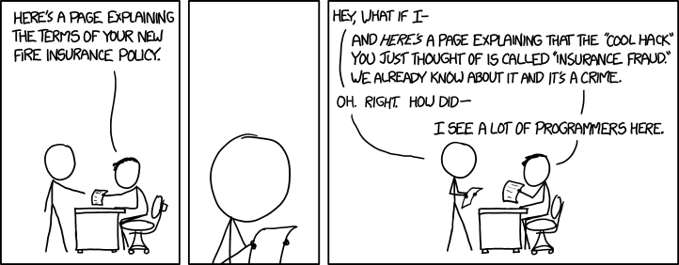
https://xkcd.com/1494/

Slide 40
Ways not to save money
Lying
Incorrectly specifying vehicle usage
Rating the vehicle in a different location than it’s garaged
Failing to disclose tickets and accidents
Lower Limits
Choose higher deductibles (within reason) instead
Picking the carrier with the most discounts
You can create as many discounts as you want by specifying the base rates as the riskiest driver
Making Major Life Decisions For Cheaper Auto Insurance
Getting Married
Changing Gender
Move to a state with lower insurance

Slide 41
Additional References
Basic Ratemaking (PDF)– Werner & Modlin
Estimating Unpaid Claims Using Basic Techniques (PDF) – Friedland
Be An Actuary (Website)
The State of Auto Insurance (Website) – The Zebra
Kansas Department of Insurance (Website)
This Person Does Not Exist (Website)
XKCD (Website) – Randal Monroe
Gator Country (Website) – Spooner’s Home

Slide 42
Contact
LinkedIn ActuarialHero
Email ActuarialHero@gmail.com

Slide 43
Questions?
Insurance Industry Overview
Personal Auto
How to Save Money on Auto Insurance
How Not to Save Money on Auto Insurance
Questions

